Slide 1
Tesla, Gernsback, and the Birth of Science Fiction
Miriam Seidel PHILCON 11-16-18 http://miriamseidel.com

Slide 2
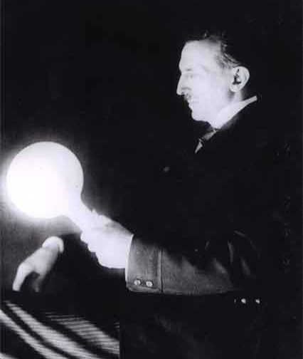

Slide 3
HUGO GERNSBACK Born Luxembourg, 1884 Died New York, 1967

Slide 4
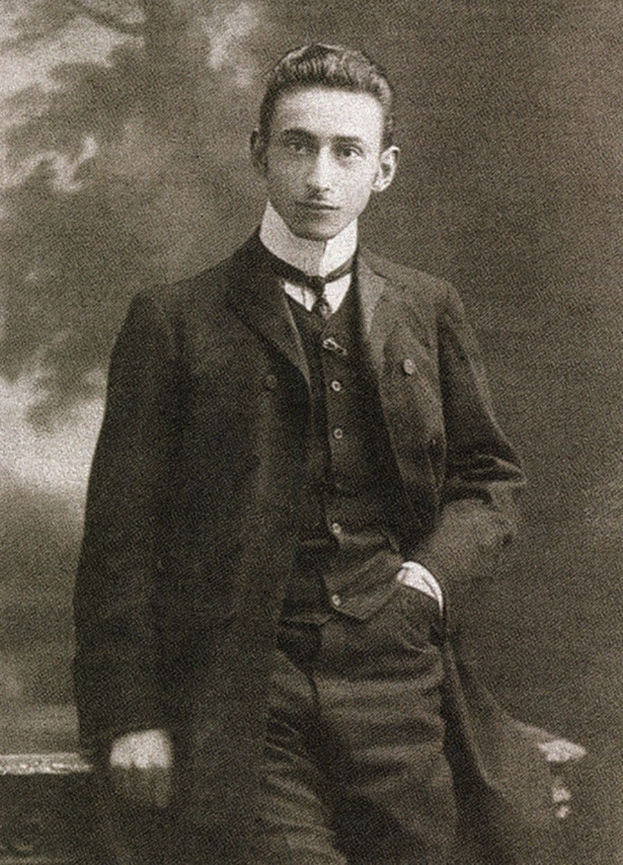
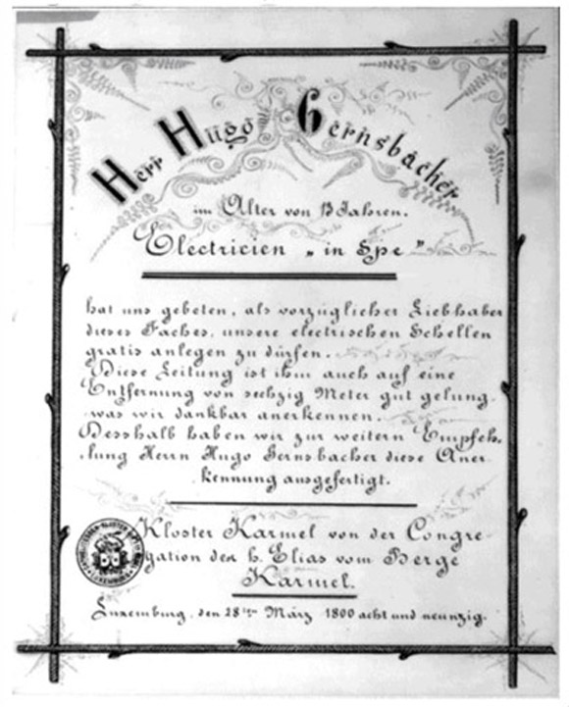

Slide 6
NIKOLA TESLA Born Croatia, 1856 Died New York, 1943

Slide 8
TESLA’S MAJOR BREAKTHROUGHS
Alternating current: Dynamo, step-down transformer (Tesla coil)
Radio and wireless technologies
Teleautomatics / Robotics
Computer circuitry
PIONEERING WORK in
- X-rays, cosmic rays, fluorescent light, VTOL flight, turbines
PATENTS – 278 known

Slide 11
Wardencliffe – Tesla’s world Broadcasting Project t

Slide 14
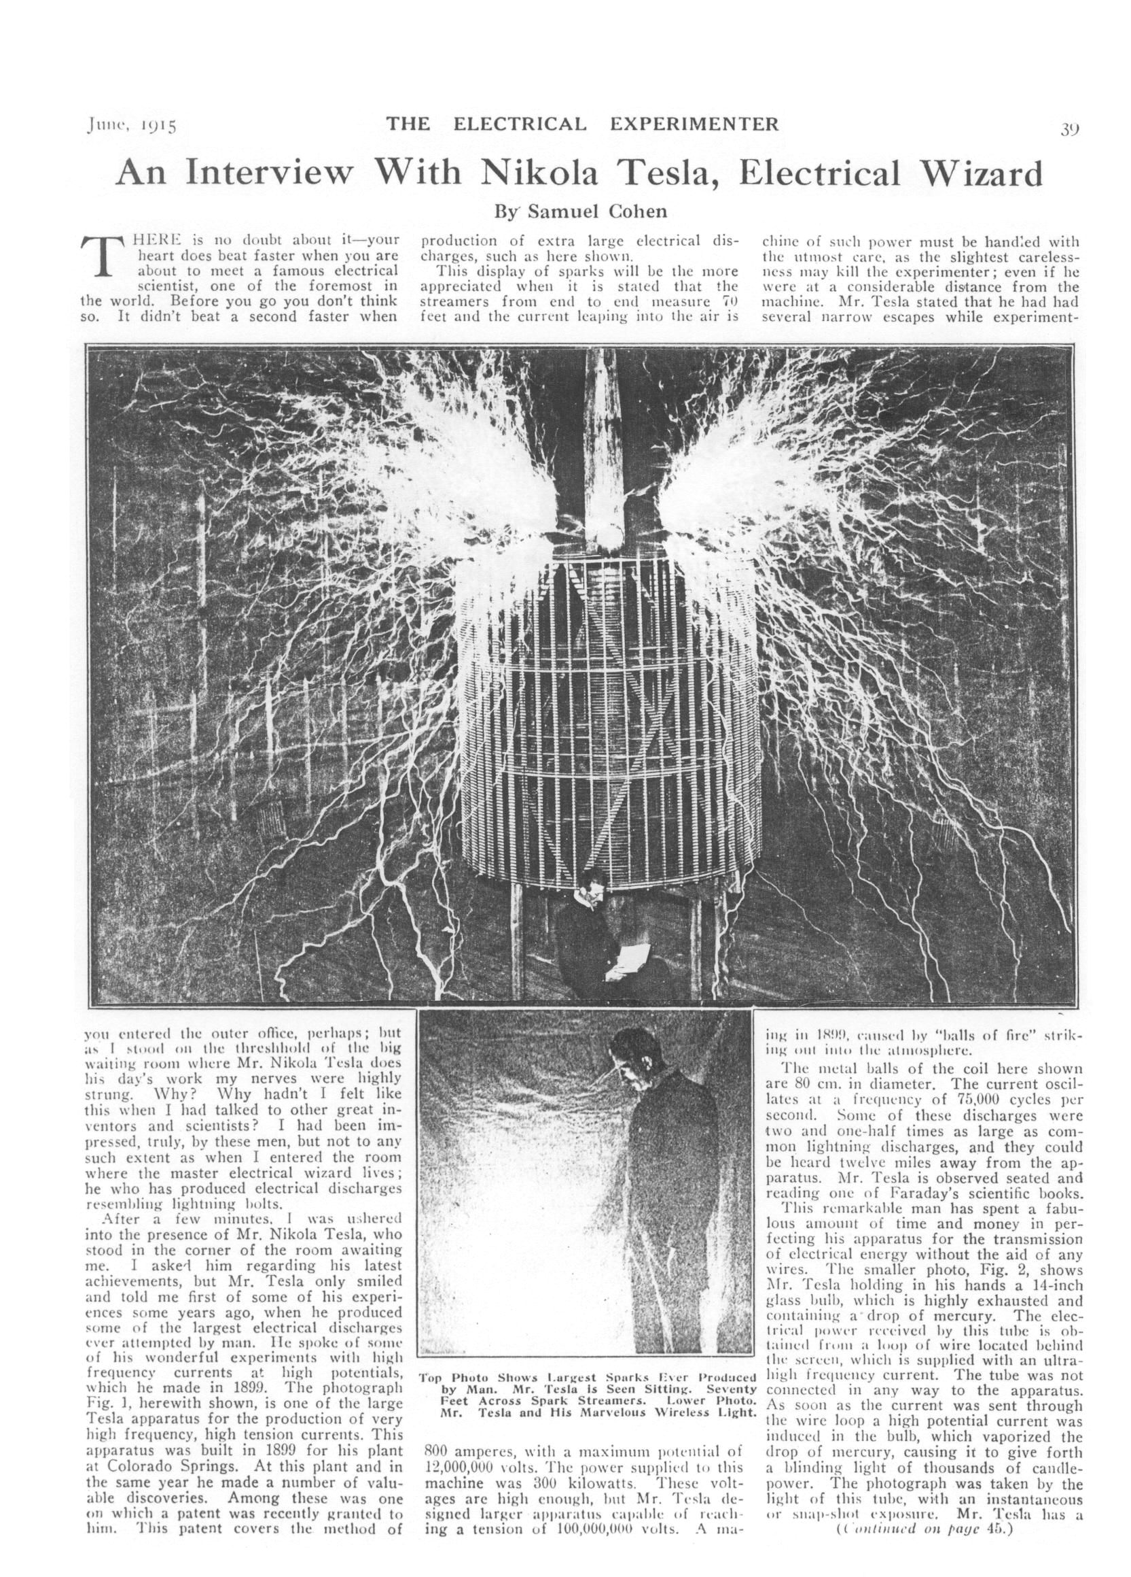

Slide 15
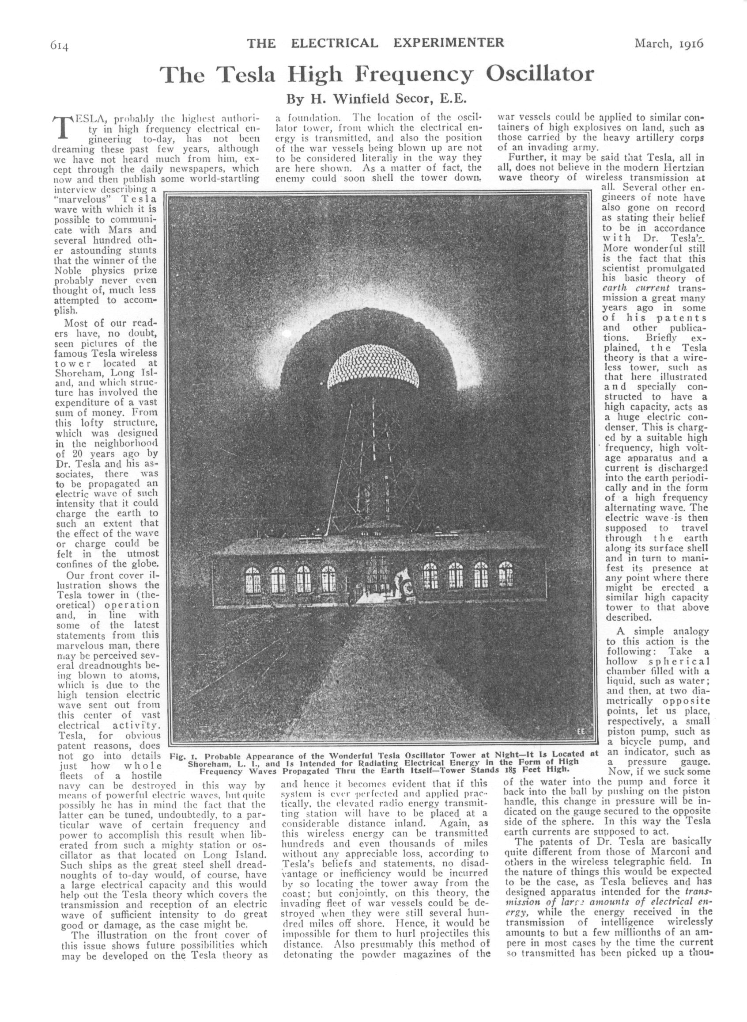

Slide 16
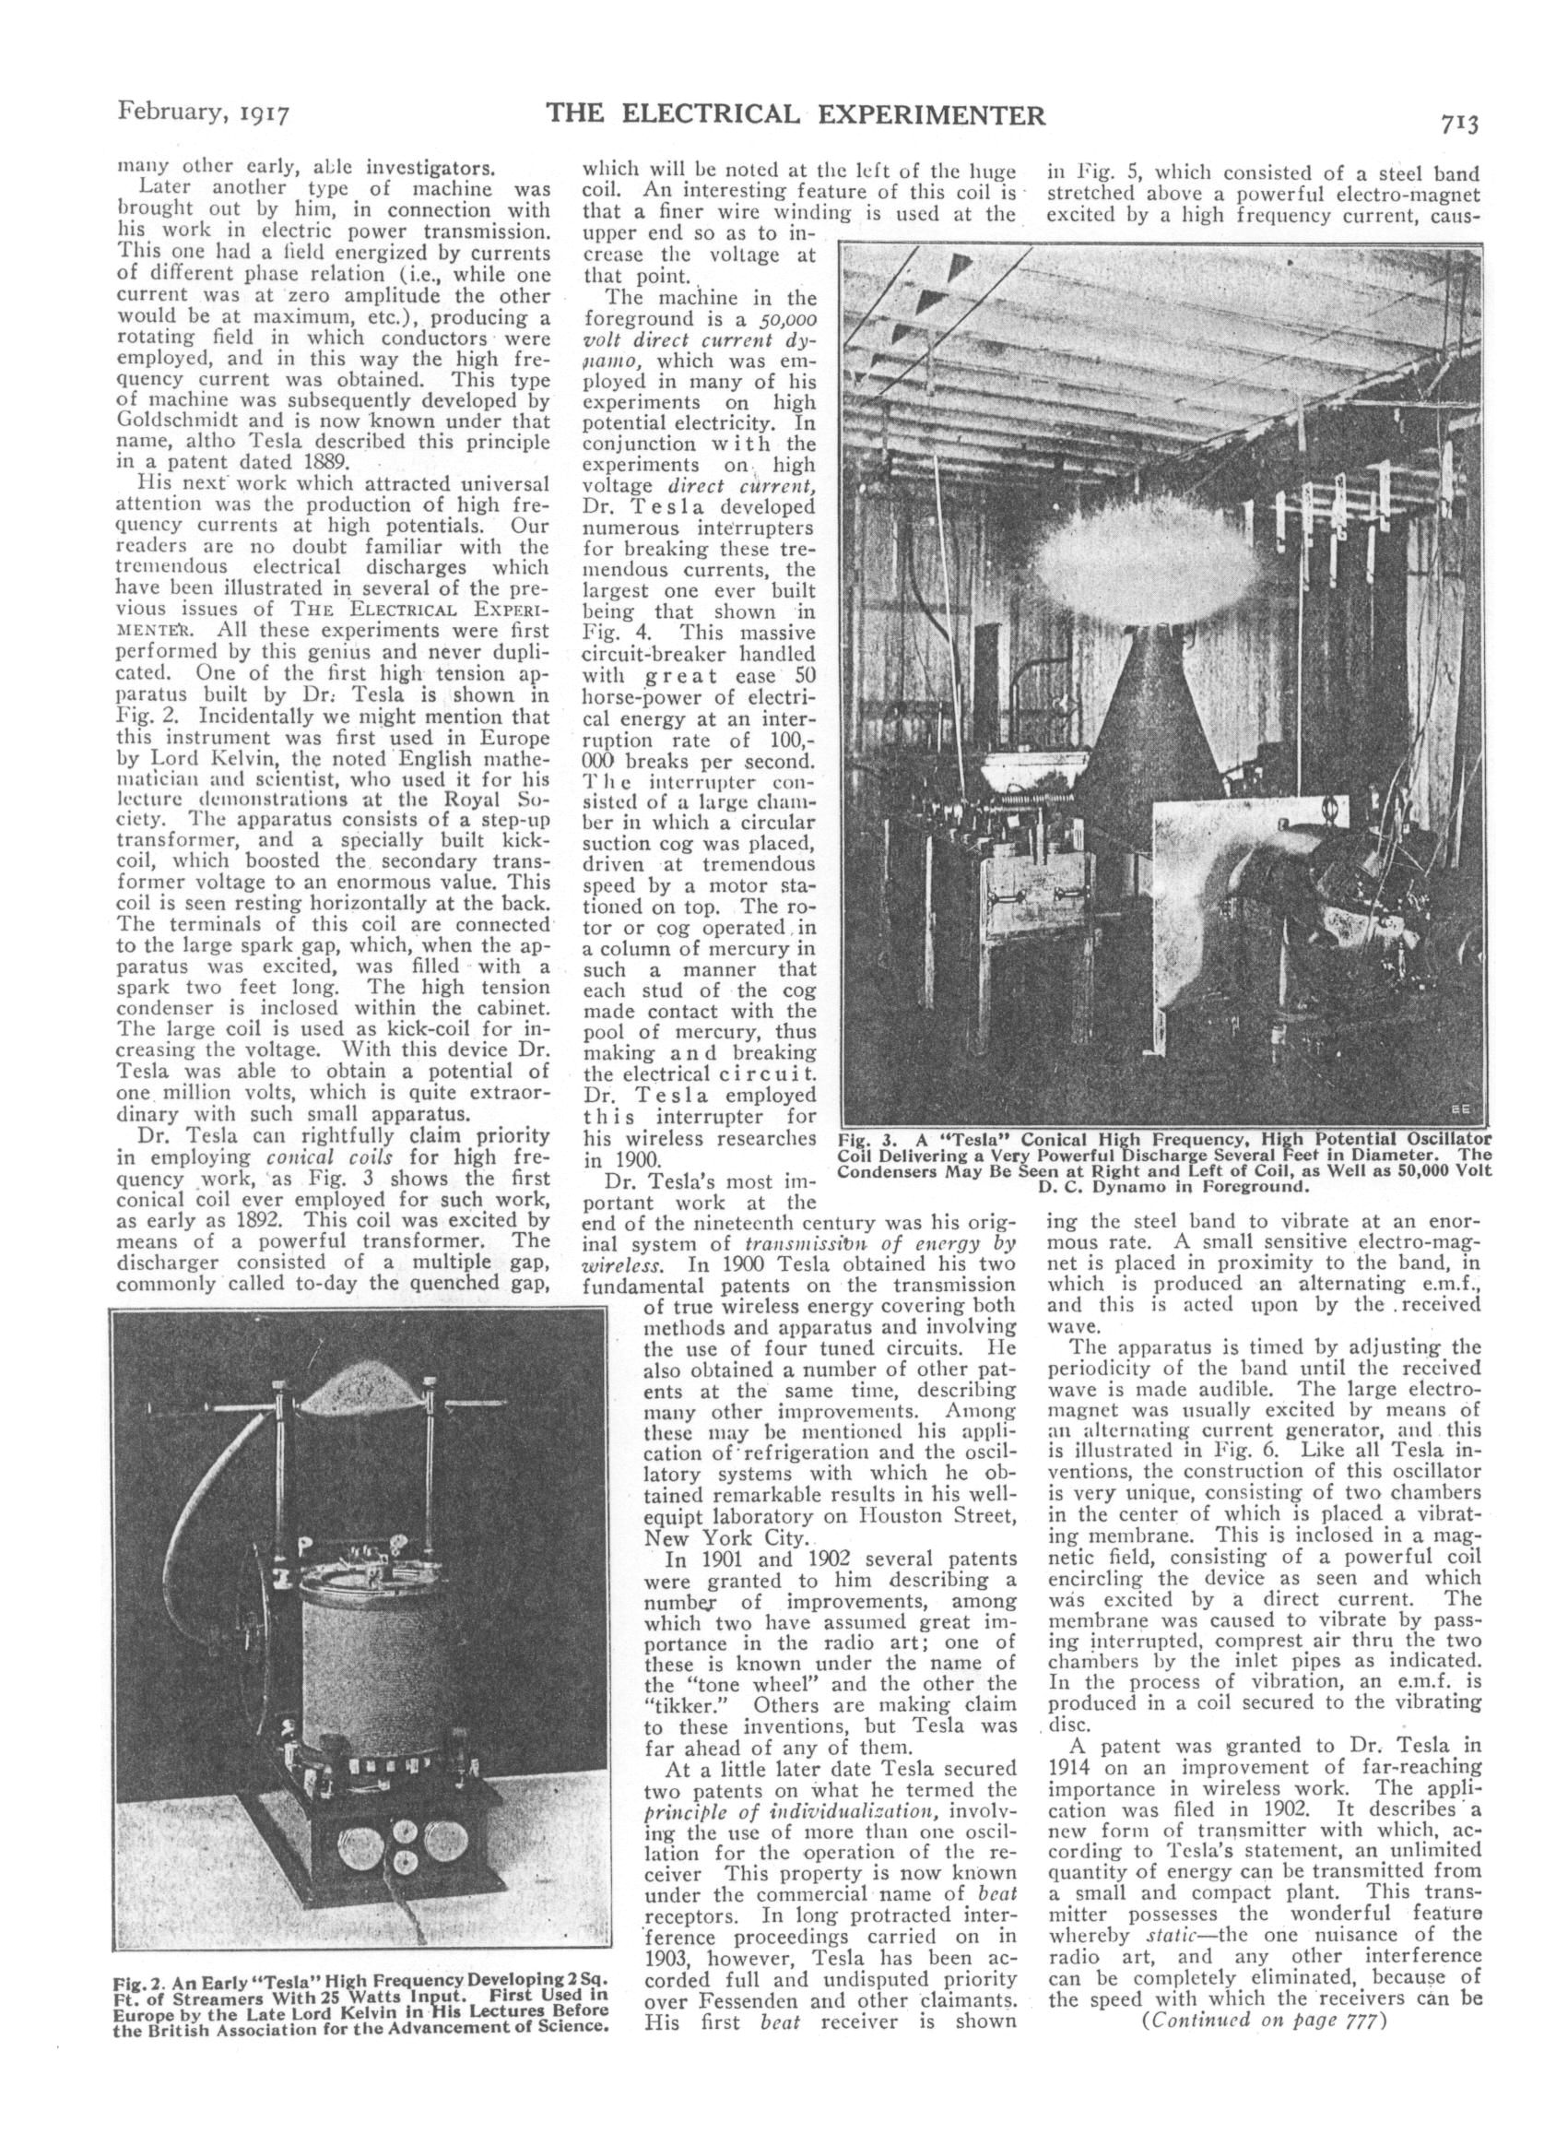

Slide 17
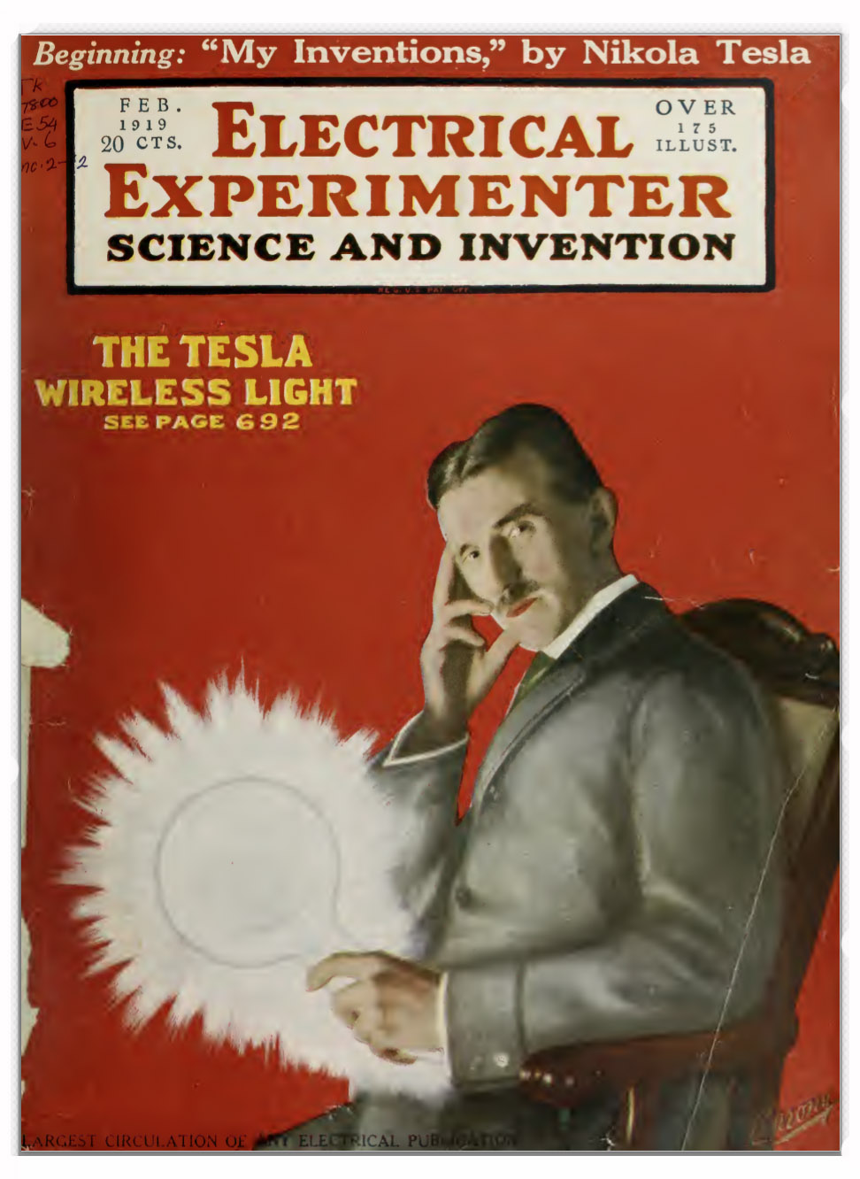

Slide 18
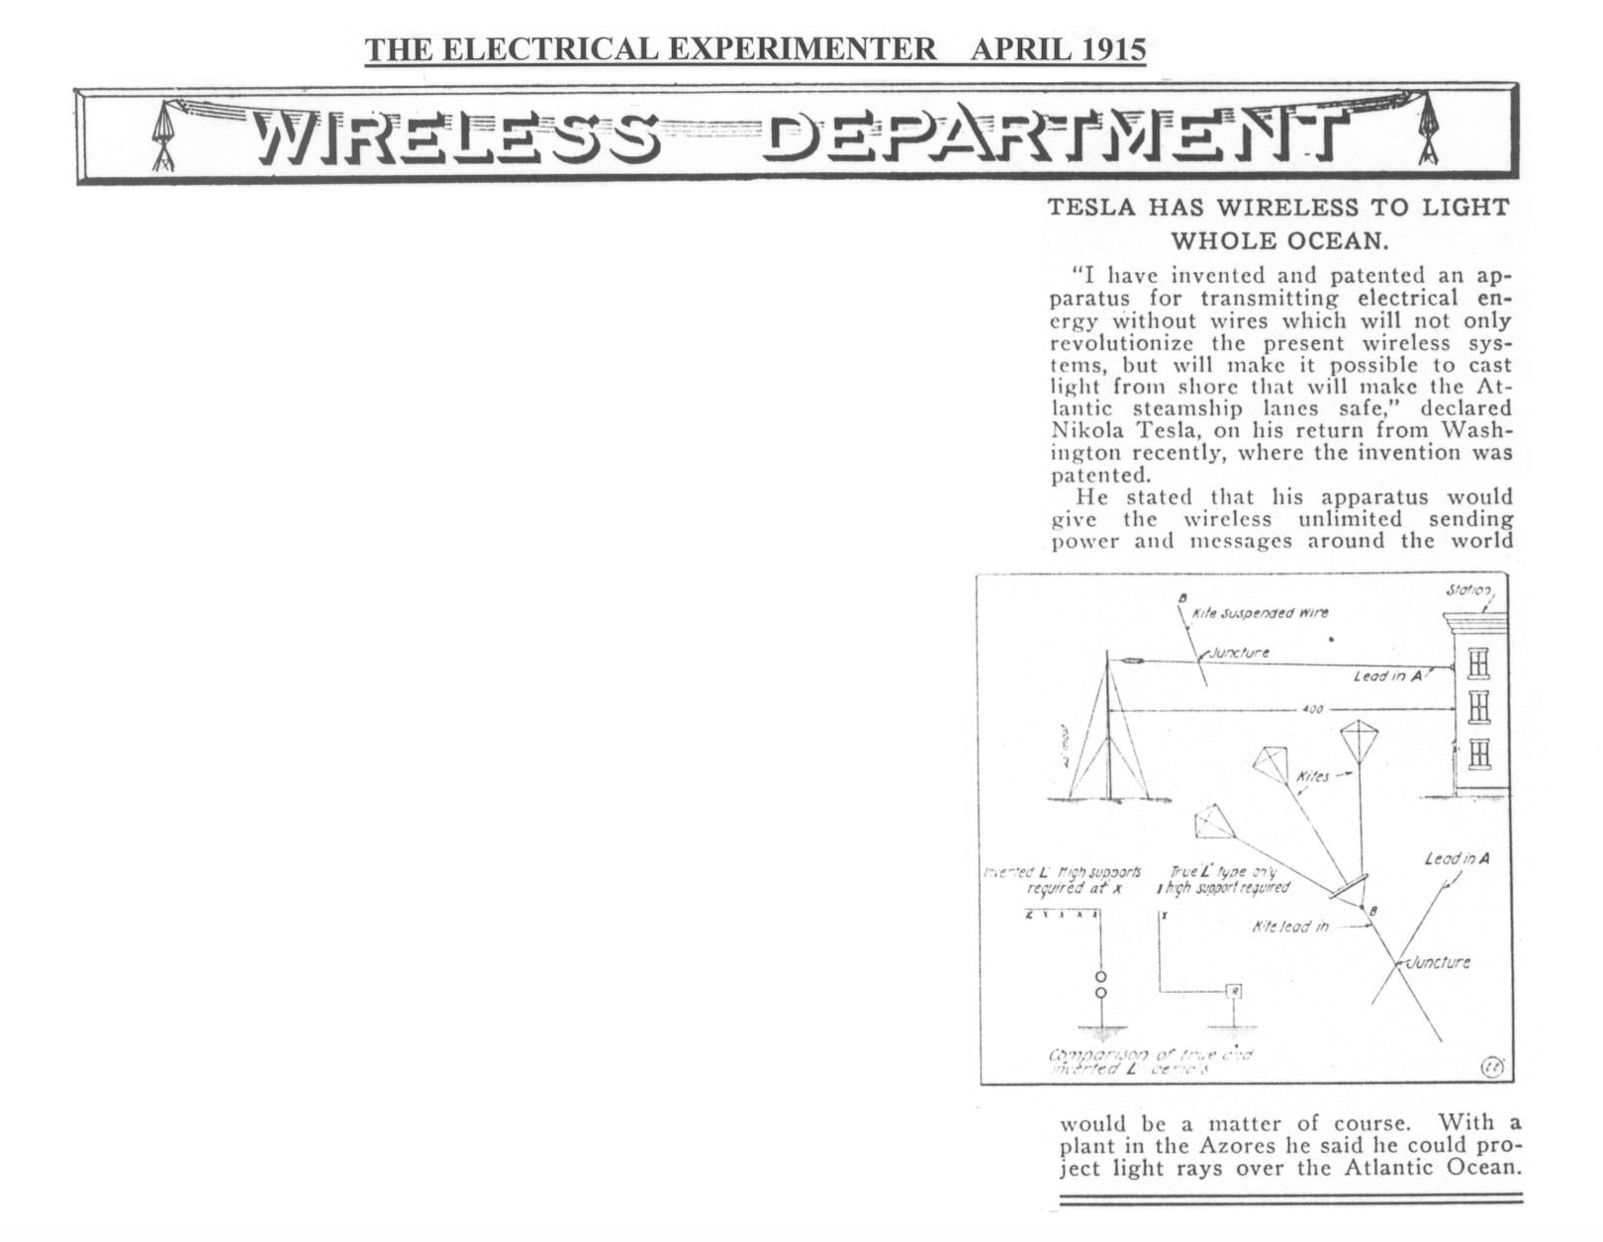

Slide 20
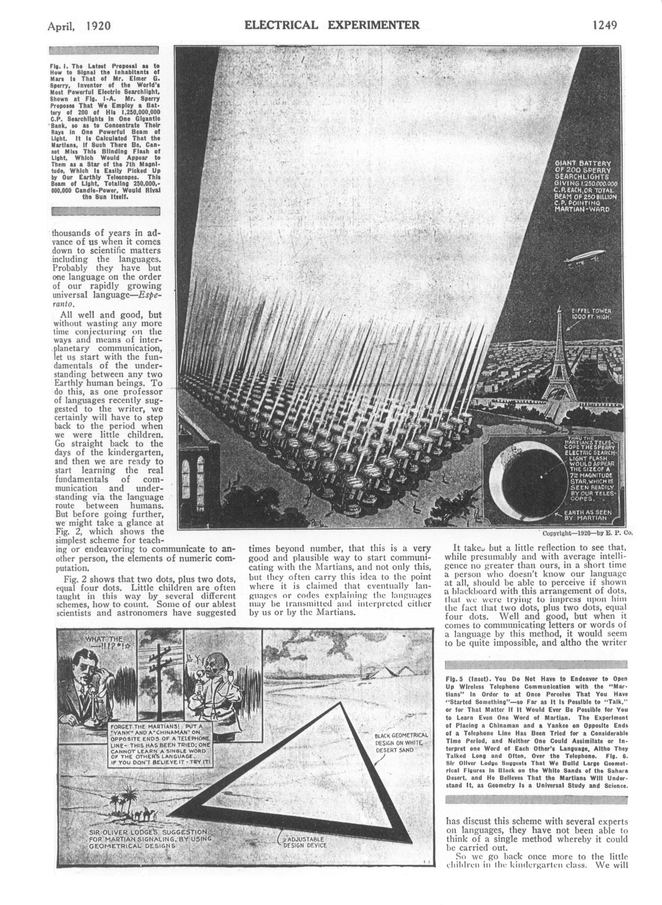

Slide 22
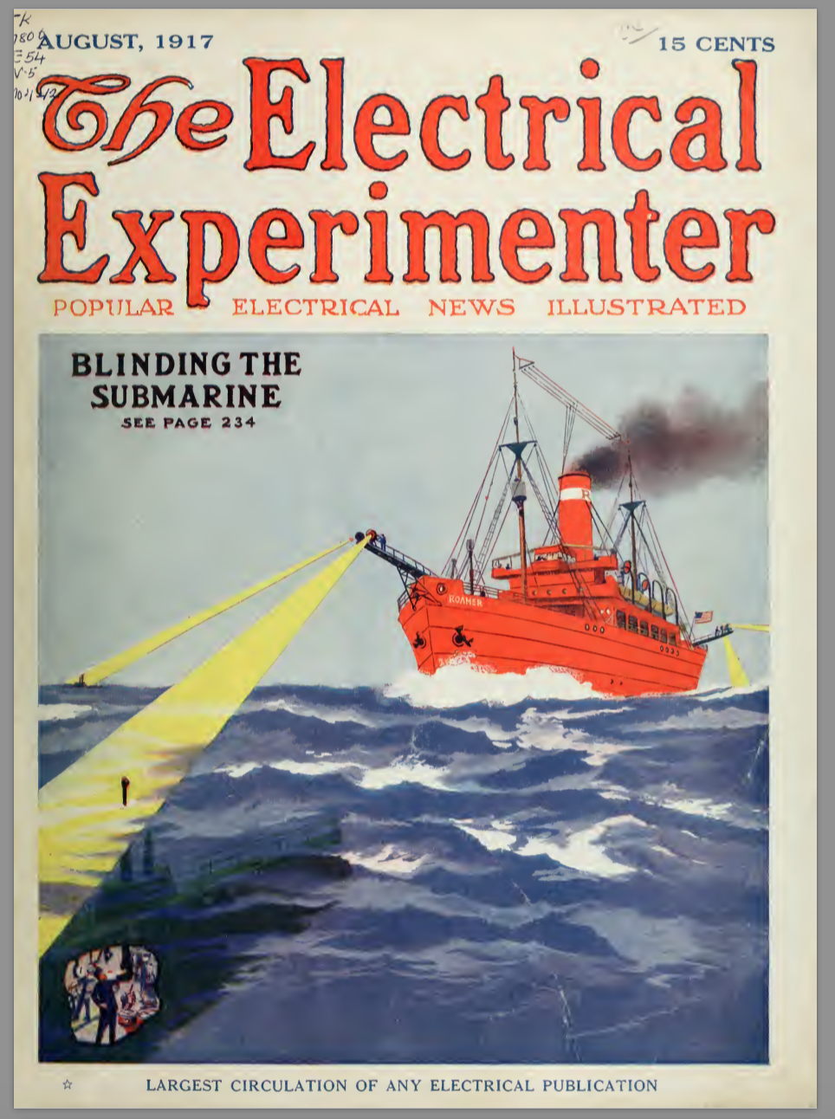

Slide 28
TESLA IN POPULAR CULTURE
NOVELS FILMS
- The Prestige – Christopher Priestley - The Secret of Nikola Tesla
- Goliath – Scott Westerfield - The Prestige
- The Invention of Everything – - The Current Wars
Samantha Hunt
STEAMPUNK
GRAPHIC NOVELS – The Inventor TV – Murdoch’s Mysteries
MUSIC - Laurie Anderson, Melissa Dunphy, Kline/Jarmusch, Gibson/Seidel

Slide 29
VIOLET FIRE an opera about Nikola Tesla Jon Gibson, music Miriam Seidel, libretto violetfireopera.com

Slide 30
VIOLET FIRE an opera about Nikola Tesla Jon Gibson, music Miriam Seidel, libretto violetfireopera.com

Slide 31
VIOLET FIRE an opera about Nikola Tesla Jon Gibson, music Miriam Seidel, libretto violetfireopera.com

Slide 32
VIOLET FIRE an opera about Nikola Tesla Jon Gibson, music Miriam Seidel, libretto violetfireopera.com

Slide 35
Tesla, Gernsback, and the Birth of Science Fiction
Miriam Seidel PHILCON 11-16-18 http://miriamseidel.com

